Slide 1
Supplemental Training Content:
Title IX Coordinator and CEO
Report Templates
Notes:
Title Slide: Supplemental Training Content on the Report Templates
Title IX Coordinator (TIXC) Report Template
Chief Executive Officer (CEO) Report Template

Slide 2
Agenda Outline
Title IX Coordinator (TIXC) Report Template
  Appendix A: TIXC Report (Table format)
    Table 1: Alleged Conduct Reported by Employees (that constitutes sexual harassment, sexual assault, dating violence or stalking)
    Table 2: Alleged Conduct Reported about Employees (that constitutes an employee’s failing to report or false reporting on sexual harassment, sexual assault, dating violence or stalking)
  Appendix B: Summary Data Report (Table format)
Chief Executive Officer (CEO) Report Template
  Appendix A: Summary Report Data (Table format)
Notes:
2021 note: Templates have been revised. Please use the templates posted on the THECB website.

Slide 3
1. Title IX Coordinator (TIXC) Report
Notes:
Title Slide: Title IX Coordinator Report

Slide 4
Title IX Coordinator Report: Introduction
The institution’s Title IX Coordinator (TIXC) is responsible for submitting a written report to the institution’s Chief Executive Officer (e.g. President of the institution) at least once every three months; effective January 1, 2020.
  For the 2019-2020 academic year: Reports compilated for the TIXC Report will include reports received by employees starting on January 1, 2020 through the reporting period of the TIXC Report.
  For the 2020-2021 academic year, and so forth: Reports compilated for the TIXC Report can be compiled/organized (as an example) by academic year, for the reporting period of the TIXC Report.

Slide 5
Title IX Coordinator Report: Introduction
(continued)
The THECB will make available a “recommended template” to the institutions for the Title IX Coordinator Report, which will satisfy the reporting requirements of this section for the THECB.
Using the report template is not required by the institutions, but for training purposes of this supplemental section, the recommended template will be used for this slideshow.
Notes:
2021 note: Template has been revised and posted on the THECB website.

Slide 6
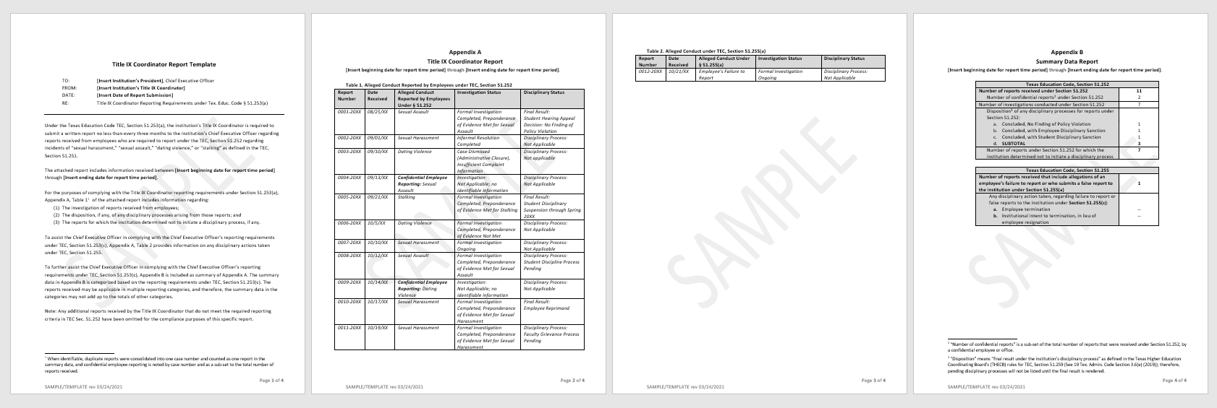
TIXC Report Template: “How-to” Guide
Notes:
Intro slide for the TIXC Report Template.
Screenshot of the TIXC Report Template; not for reading purposes, just a visual on this title slide.
Refer to the TIXC Report Template while following along in this slideshow.

Slide 7
Appendix A: TIXC Report
Table 1: Alleged Conduct Reported by Employees (that constitutes sexual harassment, sexual assault, dating violence or stalking)
Table 2: Alleged Conduct Reported about Employees (that constitutes an employee’s failing to report or false reporting on sexual harassment, sexual assault, dating violence or stalking)
Notes:
Title Slide: Appendix A – TIXC Report

Slide 8
Table 1: Alleged Conduct Reported by Employees
Sexual harassment
Sexual assault
Dating violence
Stalking
Notes:
See Tex. Edu. Code § 51.252
Depending on an institution’s policy definitions, “sexual harassment” as defined in Tex. Edu. Code § 51.251, may also include but is not limited to an institution’s definitions of sexual misconduct, sexual exploitation, sexual harassment, gender-based harassment, or other types of inappropriate conduct of a sexual or sex-based nature.
For the purposes of compiling with the administrative reporting requirements, the term “sexual harassment” will be used in the report template as an umbrella term for all types of alleged conduct that meet the state’s definition of “sexual harassment.”
See Tex. Edu. Code Section 51.253(a) for the TIXC reporting requirements

Slide 9
1. Criteria for including a report on the TIXC Report
Include the report when the following criteria is met:
The information was submitted by an employee (e.g. employee third-party reporter, employee bystander, employee witness); and
The type of incident described in the employee’s report constitutes “sexual harassment,” “sexual assault,” “dating violence,” or “stalking”
Notes:
Background:
TIXC receives information directly from complainants (alleged victim), other students/peers, employees, or non-employees.
TIXC receives information that is unknown/not identifiable as a specific type of conduct (“sexual harassment,” “sexual assault,” “dating violence,” or “stalking”) that is reportable under the administrative reporting requirements.
Examples for non-reportable information is included on subsequent slides.

Slide 10
Example 1
A parent of a student reports to the institution’s TIXC that a student has been sexually harassed by Faculty A throughout the semester. The TIXC hasn’t received any reports about this incident from any employees at this time.
Answer: The TIXC determines that since the report was submitted by a non-employee third-party (parent), and no reports have been submitted about this incident from employees (required reporters under the new law), the TIXC could omit this report from the TIXC Report.

Slide 11
Example 2
Student directly reports to the TIXC that they were sexually assaulted (raped) by another student, using the institution’s online report form. The TIXC hasn’t received any reports about this incident from any employees at this time.
Answer: The TIXC determines that since the report was submitted directly from the complainant (alleged victim), and no reports have been submitted about this incident from employees (required reporters under the new law), the TIXC could omit this report from the TIXC Report.

Slide 12
Example 3
Student discloses to an employee (academic advisor) that “something bad happened to them over the weekend.” The advisor gently interrupts and tells the student that they (the advisor) are a responsible employee and are required to report information to university officials (e.g. Title IX Coordinator) regarding certain types of incidents. The student declines to say anything further to the advisor.
The advisor provides the student with a handout listing various support services (in case the services may help the student, including confidential support services). The academic advisor reports all of this information to the TIXC, just in case this incident is applicable for required reporting. (example continued on next slide)

Slide 13
Example 3 (continued)
Answer: The TIXC attempts to outreach to the student to understand the situation further, but the student does not respond to any of the TIXC attempts at contact. The TIXC determines that there is not enough information to categorize this report in any of the alleged reportable conduct categories (“sexual harassment,” “sexual assault,” “dating violence,” or “stalking”), and therefore, could omit this report from the TIXC Report.
The TIXC documents/categorizes this report as “Unknown” at this time, for the TIX internal record keeping. If additional information is discovered later, this report could be recategorized, and added to the TIXC Report, once applicable.

Slide 14
2. Report compilation for a reporting period
Compile the following information:
Case number: Establish an “anchor” on the report that is non-identifiable of the individuals involved, but can be tracked back to the record, for accuracy of reporting updates on the case.
When identifiable, consolidate duplicate reports into one case number, and count the report one time in the CEO Report’s summary data.
Optional: Note any reports that were received by confidential employees.
Notes:
Institutional Considerations:
Since the TIXC Report requirement is effective January 1, 2020; the initial reporting period will start with January 1, 2020. For the 2020-2021 academic year, and so forth: Reports compilated for the TIXC Report can be compiled/organized (as an example) by academic year, for the reporting period of the TIXC Report.
TIXC’s can continue to include reports on the TIXC Report if there are updates to the investigation or disciplinary status.
Once a report’s status is final and it’s been reported to the CEO, then the report can be considered for removal on the subsequent TIXC Report, as long as the summary data is captured in the CEO Report (annually)

Slide 15
Duplicate Reports: Example
Report 1: The TIXC received a report from an employee (faculty member) that Student X disclosed in class that they (Student X) were “pushed around by their ex-boyfriend last semester” during a class activity.
Report 2: The TIXC received another report from another employee (student’s faculty mentor) about 2 weeks after report #1 was received, that Student X shared that “last semester” they (Student) X sustained “bruises on their arms and shoulder” after being “thrown into the wall by their ex-boyfriend.”

Slide 16
Duplicate Reports: Example (continued)
A: The TIXC followed-up with Student X, determines that there is enough information to collapse the two reports into one case number, since the reports identify the same complainant (alleged victim), includes descriptions of the same respondent (alleged perpetrator), and includes descriptions of similar types of dating violence during the same time period.

Slide 17
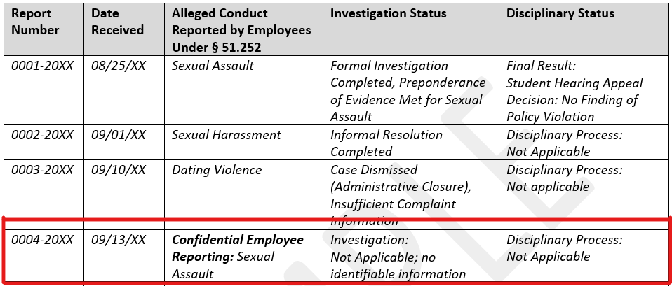
Confidential Employee Reports: Example
Notes:
Confidential Employee Report: Example (Text format)
Report Number: 0004-20XX
Date Received: 09/13/XX
Alleged Conduct Reported by Employees Under Section 51.252: Confidential Employee Reporting: Sexual Assault
Investigation Status: Investigation: Not Applicable; no identifiable information
Disciplinary Status: Disciplinary Process: Not Applicable

Slide 18
2. Report compilation for a reporting period (continued)
Compile the following information:
Date Received: The date the report was received by the TIXC; If duplicate reports are consolidated, use the date the first report was received.
Alleged Conduct Reported by Employees under § 51.252: The type of incident described constitutes “sexual harassment,” “sexual assault,” “dating violence,” or “stalking”
Investigation Status: See examples on the TIXC Report Template and/or in this training slideshow
Disciplinary Status: See examples on the TIXC Report Template and/or in this training slideshow
Notes:
“Under § 51.252” - Referring Tex. Edu. Code § 51.252, an employee’s requirement to report “sexual harassment,” “sexual assault,” “dating violence,” or “stalking.”

Slide 19
3. Investigation Status
Examples of Investigation Statuses can include but are not limited to:
Case dismissal (administrative closure); insufficient complaint information
Informal resolution pending; or completed
Formal investigation ongoing
Formal Investigation completed; preponderance of evidence met; or not met
Optional for confidential employee reports: Investigation not applicable; no identifiable information
Notes:
Institutional Considerations:
Consider capturing the institution’s response (concisely) in the Investigation Status column (see examples listed in this slide).
Institutions can determine the specific type of information to include in the Investigation Status column.

Slide 20
4. Disciplinary Status
Examples of Disciplinary Statuses can include but are not limited to:
Disciplinary process not applicable
Student/Employee disciplinary process pending
Final result of the disciplinary sanction
Final result of a disciplinary process (e.g. hearing/appeal); no finding of a policy violation
Notes:
Institutional Considerations:
After completing an investigation, consider capturing the institution’s disciplinary response (concisely), in the Disciplinary Status column.
For the following example Investigation Statuses (listed below), institutions can consider noting in the Disciplinary Status column: “Disciplinary process not applicable”
Case dismissal (administrative closure); insufficient complaint information
Informal resolution pending; or completed
Formal investigation ongoing
Investigation not applicable; no identifiable information
Institutions can determine the specific type of information to include in the Disciplinary Status column.

Slide 21
Table 2: Alleged Conduct About Employees
Regarding sexual harassment, sexual assault, dating violence, or stalking:
Employee’s failure to report
Employee’s false report
Notes:
See Tex. Edu. Code § 51.255(a)

Slide 22
1. Report compilation for a reporting period
Compile the following information:
Case number: Establish an “anchor” on the report that is non-identifiable of the individuals involved, but can be tracked back to the record, for accuracy of reporting updates on the case
When identifiable, consolidate duplicate reports into one case number, and count the report one time in the CEO Report’s summary data.

Slide 23
1. Report compilation for a reporting period
(continued)
Compile the following information:
Date Received: The date the report was received by the TIXC; If duplicate reports are consolidated, use the date the first report was received.
Alleged Conduct under § 51.255(a): “employee’s failure to report” or “employee’s false report”
Investigation Status: See examples on the TIXC Report Template and/or in this training slideshow
Disciplinary Status: See examples on the TIXC Report Template and/or in this training slideshow
Notes:
“Under § 51.255(a)” - Referring Tex. Edu. Code § 51.255(a), an employee is required to make a report and knowingly fails to make the report; or with the intent to harm or deceive, knowingly makes a report that is false.

Slide 24
3. Investigation Status
Examples of Investigation Statuses can include but are not limited to:
Case dismissal (administrative closure); insufficient complaint information
Formal investigation ongoing
Formal Investigation completed; preponderance of evidence met; or not met
Notes:
Institutional Considerations:
Consider capturing the institution’s response (concisely) in the Investigation Status column (see examples listed in this slide).
Institutions can determine the specific type of information to include in the Investigation Status column.

Slide 25
4. Disciplinary Status
Examples of Disciplinary Statuses can include but are not limited to:
Disciplinary process not applicable
Employee disciplinary process pending
Final result of the disciplinary sanction (e.g. employment termination)
Final result of a disciplinary process (e.g. hearing/appeal); no finding of a policy violation
Notes:
Institutional Considerations:
After completing an investigation, consider capturing the institution’s disciplinary response (concisely), in the Disciplinary Status column.
For the following example Investigation Statuses (listed below), institutions can consider noting in the Disciplinary Status column: “Disciplinary process not applicable”
Case dismissal (administrative closure); insufficient information
Formal investigation ongoing
Institutions can determine the specific type of information to include in the Disciplinary Status column.

Slide 26
Appendix B: Summary Data Report
Since the TIXC is responsible for completing a written report to the CEO at least every three months, which includes statuses for each report received by employees, the TIXC would be able to prepare a summary data report that could satisfy the CEO’s reporting requirement (e.g. CEO Report).
The summary data in Appendix B is categorized based on the CEO reporting requirements.
The reports received may be applicable in multiple reporting categories, and therefore, the summary data in the categories may not add up to the totals of other categories.

Slide 27
Appendix B: Summary Data Report
(continued)
Appendix B in the TIXC Report Template correlates to the sample cases listed in Appendix A (Tables 1 & 2).
The purpose of the footnotes on the TIXC Report Template: Explains the context or meaning of the terminology used in Appendix B, or caveats in the reporting data.

Slide 28
2. Chief Executive Office (CEO) Report
Notes:
Title Slide: Chief Executive Officer (CEO) Report

Slide 29
CEO Report: Introduction
The institution’s Chief Executive Officer (CEO) is responsible for:
  Submitting a summary report (CEO Report) to the institution’s governing body (e.g. Board of Regents, Board of Trustees) at least once annually, during either the fall or spring semester; and
  Posting the summary report (CEO Report) on the institution’s website at least once annually, during either the fall or spring semester; both effective January 1, 2020.

Slide 30
CEO Report: Introduction (continued)
The THECB will make available a “recommended template” to the institutions for the CEO Report, which will satisfy the reporting requirements of this section for the THECB.
Using the report template is not required by the institutions, but for meeting the reporting requirements of this section, the recommended template will be used for training purposes of this slideshow.
Notes:
2021 note: Recommended CEO Report template has been revised. Institutions should refer to the revised template on the THECB website.

Slide 31
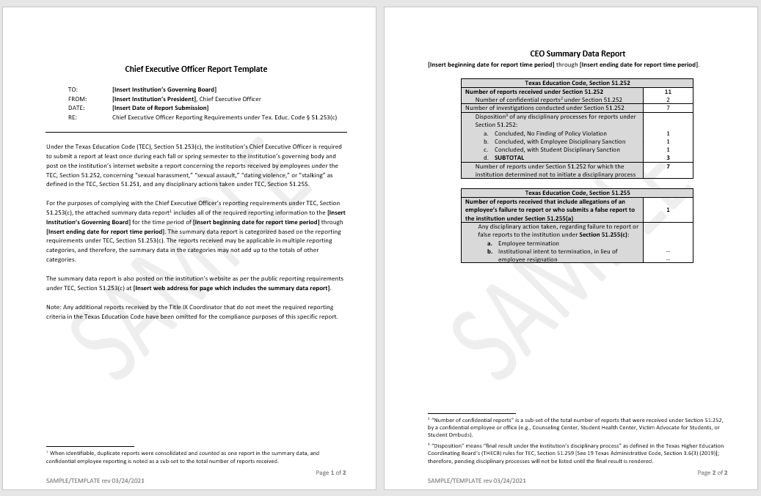
CEO Report Template: “How-to” Guide
Notes:
Intro slide for the CEO Report Template.
Screenshot of the CEO Report Template; not for reading purposes, just a visual on this title slide.
Refer to the CEO Report Template while following along in this slideshow.

Slide 32
Appendix A: Summary Data Report
As noted in the TIXC Report section of this training slideshow, since the TIXC is responsible for completing a written report to the CEO at least once every three months, which includes statuses for each report received by employees, the TIXC can prepare a summary data report as part of the TIXC Report.
The CEO could then “copy” the summary data report from the TIXC Report into their CEO Report that is required annually to the institution’s governing body and posted annually on the institution’s website, which could satisfy the CEO’s reporting requirements.
The reports received may be applicable in multiple reporting categories, and therefore, the summary data in the categories may not add up to the totals of other categories.
Notes:
See Tex. Edu. Code Section 51.253(c) for the CEO reporting requirements

Slide 33
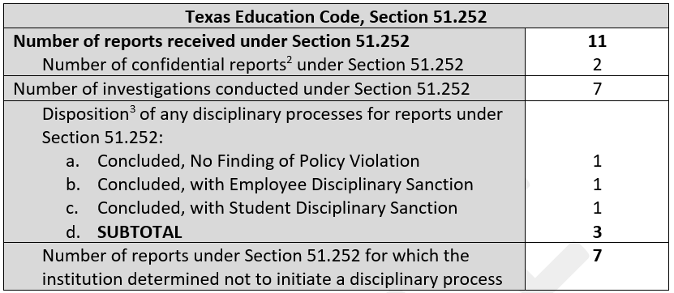
33
Notes:
From the CEO Report Template, CEO reporting requirements example based on the employee required reporting on sexual harassment, sexual assault, dating violence, and stalking (Tex. Edu. Code § 51.252) (Text Format)
Number of reports received under Section 51.252: 11
Number of confidential reports under Section 51.252: 2
Number of investigations conducted under Section 51.252: 7
Disposition of any disciplinary processes for reports under Section 51.252:
Concluded, No Finding of Policy Violation: 1
Concluded, with Employee Disciplinary Sanction: 1
Concluded, with Student Disciplinary Sanction: 1
SUBTOTAL: 3
Number of reports under Section 51.252 for which the institution determined not to initiate a disciplinary process: 7

Slide 34
Number of Confidential Reports
“Number of confidential reports” is a sub-set of the total number of reports that were received by a confidential employee or office (e.g. Counseling Center, Student Health Center, Victim Advocate for Students, or Student Ombuds).

Slide 35
Disposition
“Disposition” means “final result under the institution’s disciplinary process.”
Therefore, pending disciplinary processes are not required to be listed in the CEO Report’s Summary Data Report until the final result of the disciplinary process is rendered.
Notes:
“Disposition” as defined in the Texas Higher Education Coordinating Board’s rules for Tex. Edu. Code, §51.259 (See Chapter 3, Subchapter A, Section 3.6(e));

Slide 36
No Finding of a Policy Violation
In the “Disposition” section of the Summary Data Report:
“No finding of a policy violation” refers to instances where there is no finding of responsibility after a hearing or an appeal process; investigations completed with a preponderance of evidence not met are excluded since it would not have moved forward into a disciplinary process.

Slide 37
Did Not Initiate a Disciplinary Process
Reasons can include, but are not limited to:
Case dismissal (administrative closure);
Insufficient information to investigate;
Confidential employee reporting (no identifiable information);
The respondent’s identity was unknown or not reported;
The respondent was not university-affiliated;
The complainant requested the institution not investigate the report;
Informal resolution pending or completed;
Formal investigation is ongoing;
Formal investigation was completed with a preponderance of evidence not met.

Slide 38
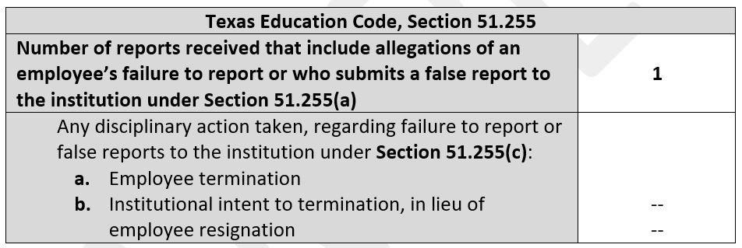
38
Notes:
From the CEO Report Template, CEO reporting requirements example based on allegations of employee’s failure to report or who submits a false report to the institution (Tex. Edu. Code § 51.255) (Text Format)
Number of reports received that include allegations of an employee’s failure to report or who submits a false report to the institution under Section 51.255(a): 1
Any disciplinary action taken, regarding failure to report or false reports to the institution under Section 51.255(c):
Employee Termination: N/A
Institutional intent to termination, in lieu of employee resignation: N/A

Slide 39
Posting the CEO’s Summary Report
(CEO Report) on the Institution’s Website
The CEO Report Template is written purposefully so that an institution could publish the summary report (CEO Report) in its entirety on an annual basis, including the memo introduction, the summary data report, and the included footnotes in the CEO Report to ensure the full context of the summary data report is explained publicly on the institution’s website.
The CEO must post the summary report (CEO Report) on the institution’s website at least once annually, during either the fall or spring semester by October of each year in order to certify in writing that the institution is in substantial compliance.

Slide 40
Posting the Exception on the Institution’s Website
If for any semester an institution has fewer than 1,500 enrolled students, the CEO shall submit and post a summary report for that semester only if more than five (5) reports were received.
If an institution meets this exception criteria in a semester: The institution may at its discretion, consider communicating to the institution’s governing body that the exception criteria was met and post on the institution’s website that the exception criteria was met, and therefore, explained publicly on the institution’s website.
Notes:
See Tex. Edu. Code Section 51.253(d) for the CEO reporting exception

Slide 41
Summary Data Reports – Example of Annual Reporting Considerations
An example of annual reporting of the CEO’s Summary Data Report could be in the form of academic year compilations; with annual updates to the data sets, as appropriate/applicable.
Then, each academic year’s compilation could be a stand-alone data set, with its own sub-webpage dedicated by academic year
  2019-2020 (only January-August 2020)
  2020-2021 (full academic year compilation; September 2020-August 2021)
  2021-2022 (full academic year compilation; September 2021-August 2022);
  So on and so forth

Slide 42
Questions or clarifications needed on the Reporting Templates?
Contact the THECB:
Cathie A. Maeyaert, J.D.
Director for Private Postsecondary Institutions
Title IX Coordinator for Higher Education Institutions
Direct Phone: (512) 427-6527
Email: cathie.maeyaert@highered.texas.gov

